Slide 1
Topic/Objective: Finding Net Force & the resulting motion
Cornell Notes:
EQ (I can Statement):
I can analyze a force diagram to find the NET FORCE.
I can predict the motion of an object based on the NET FORCE.

Slide 2
Force Diagrams can be created for any ’system’ that is specified with boundaries.

Slide 3
B
System A: The hitter & the ground
Each foot
F_{N}
F_{N}
The player’s weight
F_{g}
A
System B: The hitter & his cap
Force Diagrams can be created for any ’system’ that is specified with boundaries.
F_{N}
The cap’s weight
F_{g}

Slide 4
NET FORCE:
The sum of the forces acting on an object or system.
Notation: F_{NET} or Σ F
Greek letter: Sigma
In math and science means ‘sum of’

Slide 5
Rules for combining forces
Establish directions for the vectors.
Use positive and negative signs to show directions.
Combine Co-linear forces with addition
Combine ‘at an angle‘ forces with trigonometry
We don’t do this in 9th grade Physics since most students have not had trigonometry

Slide 6
Up = +
Down = -
12 N
.
Up-and-down forces
F_{NET} = -12N + 12 N = 0
2 N
Right = +
Left = -
2 N
Side-to-side forces
F_{NET} = -2N + 2 N = 0
The net force is 0 N.
The forces are BALANCED.
12 N

Slide 7
Equilibrium means that forces on an object are BALANCED.
F _{net} = 0 Σ F = 0
Objects that are in equilibrium can be MOVING or STILL.

Slide 8
Static equilibrium
An object in static equilibrium
is still (not moving) and all forces acting on it are BALANCED.
Motion: Still, at rest, . not moving
v = 0 and a = 0
F _{net} = 0
Σ F = 0

Slide 9
DYNAMIC equilibrium
An object in dynamic equilibrium
is moving at a constant velocity and all forces acting on it are BALANCED.
Motion: moving at constant velocity
v = 0 and a = 0
F _{net} = 0
Σ F = 0

Slide 10
Disequilibrium: Unbalanced Forces
When forces on an object are not balanced,
the object is in a state of disequilibrium.
When an object is in disequilibrium,
it MUST be accelerating.
Objects in disequilibrium
will ALWAYS accelerate
in the direction of the net force.

Slide 11
Up = +
Down = -
Right = +
Left = -
This object is in DISEQUILIBRIUM. The NET FORCE is to the right so it is ACCELERATING to the right.

Slide 12
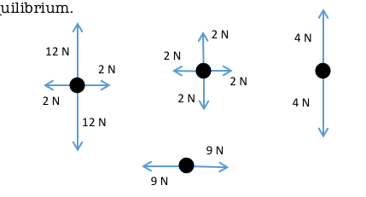
It is impossible to know if they are AT REST or MOVING AT CONSTANT VELOCITY without more information.
All of these force diagrams show objects in equilibrium.

